Slide 1


On the Jensen–Shannon Symmetrization of Distances Relying on Abstract Means
1904.04017
Video abstract
Entropy 2019, 21(5), 485
arxiv:1009.4004
Frank Nielsen
Sony Computer Science Laboratories Inc.

Slide 2
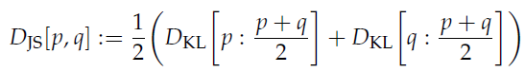
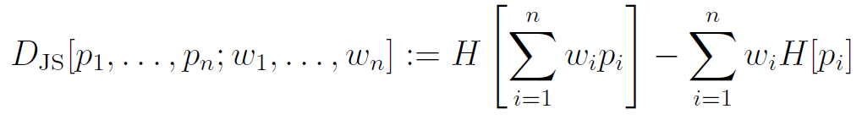
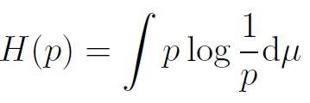
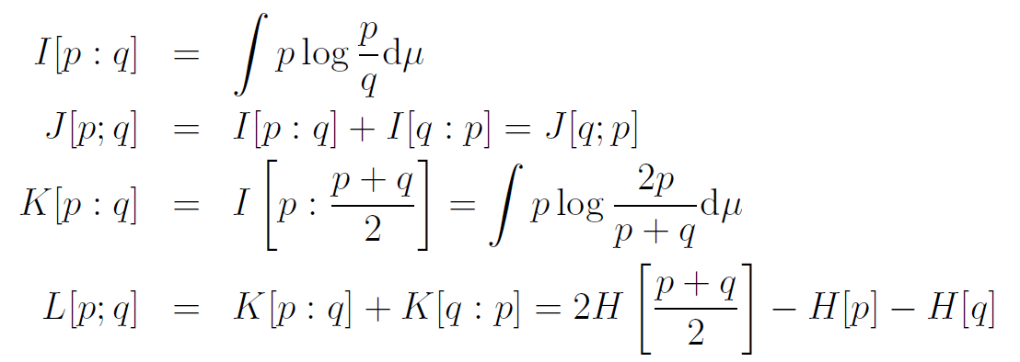
Two historical roots of the celebrated Jensen-Shannon divergence (1/2)
Lin (1991): Jensen-Shannon divergence defined as a generalization of the
L divergence (divergence when n=2 and diversity index when n>2):
where I (Kullback-Leibler divergence), J (Jeffreys divergence), K, L divergences are defined by
⬅ common definition of the JSD
(= symmetrization of the K-divergence)
with
JS diversity➡️
entropy
"Entropy of the average distribution minus the average of the entropies"
⬅ asymmetric
⬅ asymmetric
see also arxiv:1009.4004
Notes:
$$
H(p)=\int p\log\frac{1}{p}\dmu
$$
$$
D_\JS[p_1,\ldots,p_n;w_1,\ldots,w_n]:= H\left[\sum_{i=1}^n w_ip_i\right]-\sum_{i=1}^n w_i H[p_i]
$$
\begin{eqnarray*}
I[p:q] &=& \int p\log\frac{p}{q}\dmu\\
J[p;q] &=& I[p:q]+I[q:p] = J[q;p]\\
K[p:q] &=& I\left[p:\frac{p+q}{2}\right]= \int p\log\frac{2p}{p+q}\dmu\\
L[p;q] &=& K[p:q]+K[q:p] = 2 H\left[\frac{p+q}{2}\right]-H[p]-H[q]
\end{eqnarray*}

Slide 3
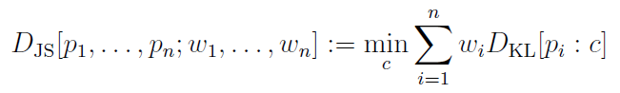
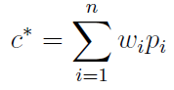
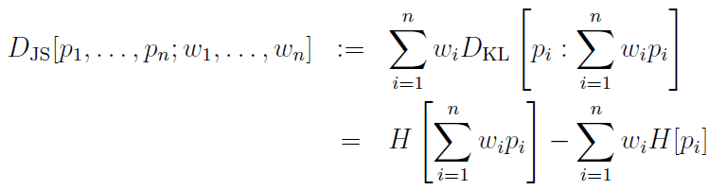
Two historical roots of the celebrated Jensen-Shannon divergence (2/2)
Sibson (1969): Jensen-Shannon divergence as an "information radius" by studying a variational problem relying on Rényi α-divergences and Rényi α-means for aggregating these Rényi α-divergences [Entropy 2021, 23(4), 464]
When α=1, the information radius of order 1 corresponds to the Jensen-Shannon divergence/diversity index (1-mean=arithmetic):
KLD right centroid:
JS diversity➡️

Slide 4
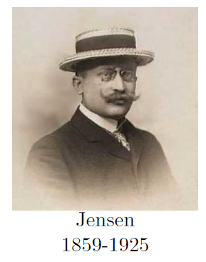
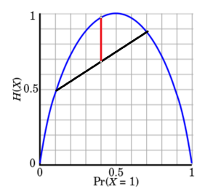
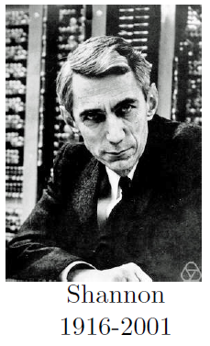
Key properties of Jensen-Shannon divergence and its computational limitation
Jensen-Shannon divergence stems from Jensen's inequality on minus the concave function of Shannon entropy
Jensen-Shannon divergence is always upper bounded by log 2
(important property when distributions have different supports)
The square root of the Jensen-Shannon divergence is a metric distance. However, JSD usually not computationally tractable for continuous distributions because of the integral of the log mixture density:
Some remarkable exceptions: E.g., KLD between mixtures of two Cauchy distributions in closed form! However, KLD between Gaussian mixtures is provably not analytic.
[arXiv:2104.13801]

Slide 5
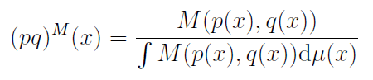
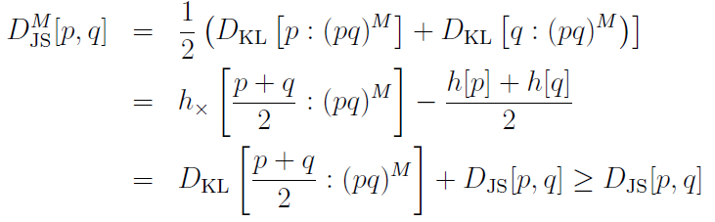
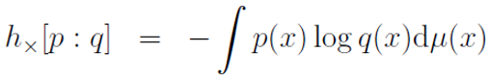
Generalizing the Jensen-Shannon divergence using abstract means to define generic statistical mixtures
Consider a generic mean M(a,b) and define the statistical (pq)^{M} mixture:
M-Jensen-Shannon divergence upper bounds the ordinary JSD:
(when M(a,b) is the arithmetic mean,
the normalization constant is one)
Cross-entropy:

Slide 6
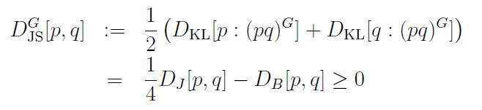
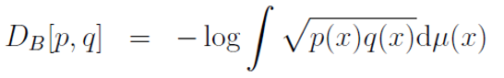
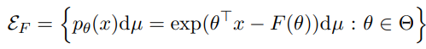
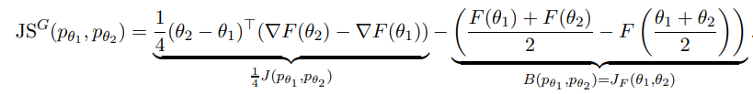
The geometric Jensen-Shannon divergence
JS obtained for the geometric mixture instead of the arithmetic mixture:
where J is the Jeffreys divergence and D_{B} is the Bhattacharyya distance
When densities p and q belong to a same exponential family E_{F},
we get a closed-form formula for the G-JSD:
where

Slide 7
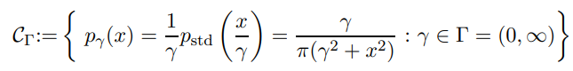
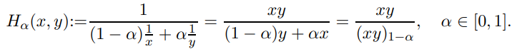
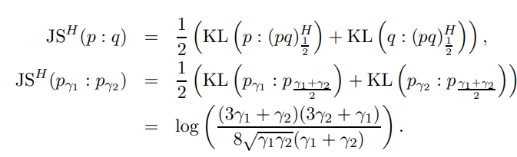
The harmonic Jensen-Shannon divergence
H-JSD is well-suited for getting closed-form between Cauchy distributions
Weighted harmonic mean:
Get closed-form formula for H-JSB between Cauchy densities:

Slide 8
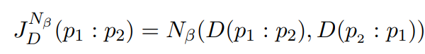
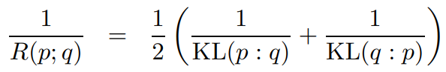
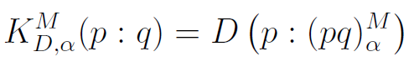
JS-symmetrization of any arbitrary distances D
N-Jeffreys symmetrization: Use a generic weighted mean N(a,b) to average the sided divergences:
⇒ recover resistor average div. of Johnson and Sinanovic (2001)
M-K symmetrization:
(M,N) JS-symmetrization: use two generic means M(a,b) and N(a,b) to define the of an arbitrary distance D:
M-K sided divergences

Slide 9
Jensen-Shannon diversity index:
Jensen-Shannon divergence (n=2):
N,M
Two abstract means

